Slide 1
SQL Query Case Study
(SELECT Query – Beginner Level)
There are 2 tables name as follows
Customer
Items_ordered
Structure of these 2 tables as follows
Table: Customer
Customer id int
firstname text
lastname text
city text
state text
Table: Items_ordered
customerid int
order_date text
item text
quantity int
price int
Prasun Karar

Slide 2
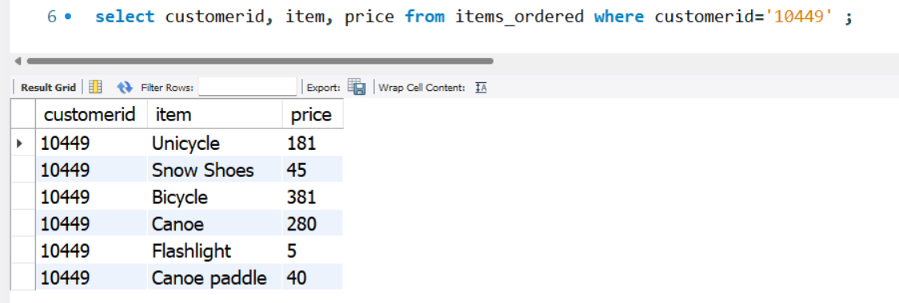
(Comparison Operators)
1. From the items_ordered table, select a list of all items purchased for customerid 10449.
Display the customerid, item, and price for this customer.
Prasun Karar

Slide 3
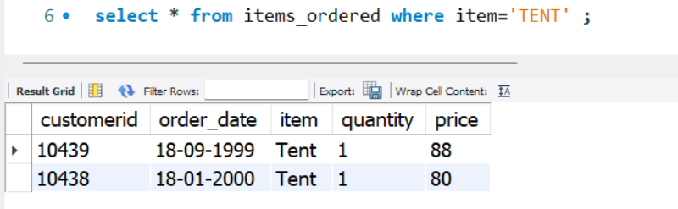
(Comparison Operators)
2. Select all columns from the items_ordered table for whoever purchased a Tent.
Prasun Karar

Slide 4
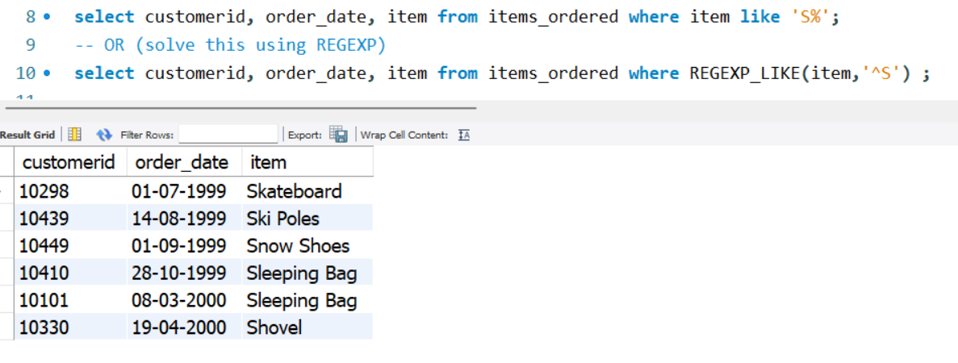
(Comparison Operators)
3. Select the customerid, order_date, and item values from the items_ordered table for any
items in the item column that start with the letter "S".
NOTE: Regular Expression is the alternate way of using comparative operator(= , > , < ,>=, <= , !=
Prasun Karar

Slide 5
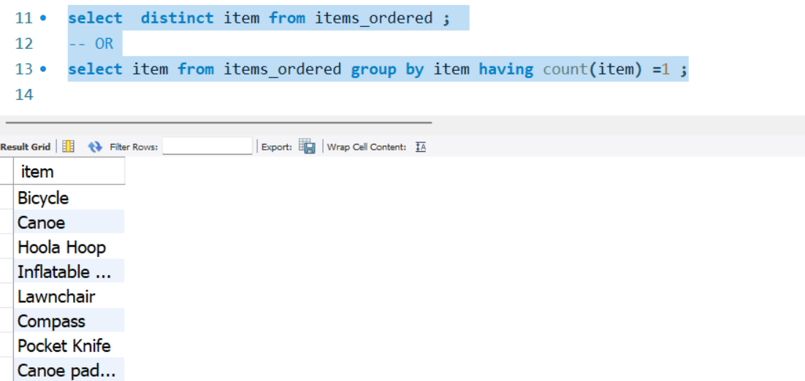
(Comparison Operators)
Select the distinct items in the items_ordered table. In other words, display a listing of each
of the unique items from the items_ordered table.
Prasun Karar

Slide 6
(Aggregate Functions)
Select the maximum price of any item ordered in the items_ordered table. Hint: Select the
maximum price only.
select max(price) from items_ordered ;
-- OR
select * from items_ordered order by price desc limit 1 ;
-- OR (for 3rd highest)
select * from (select * from items_ordered order by price desc limit 3) as tbl order by price asc limit 1 ;
Prasun Karar

Slide 7
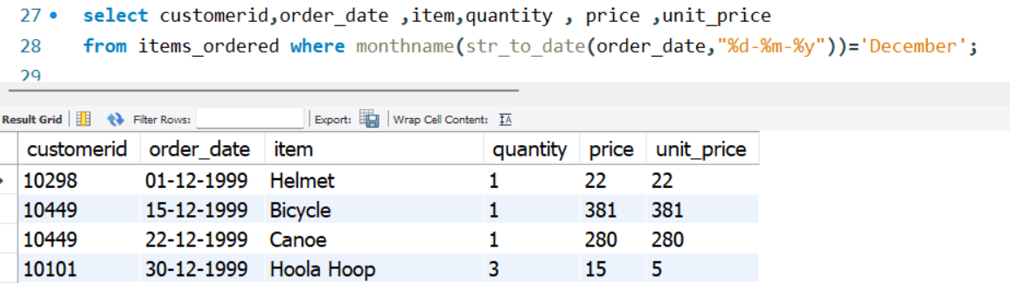
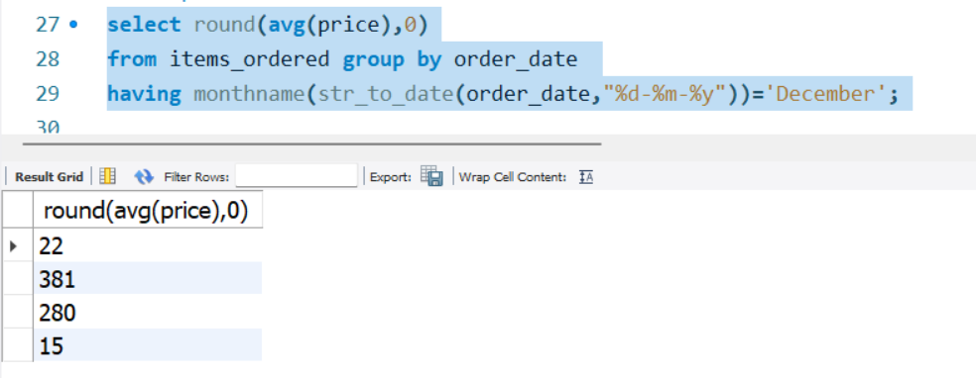
(Aggregate Functions)
Select the average price of all of the items ordered that were purchased in the month of Dec.
select round(avg(price),0)from items_ordered group by order_date having monthname(str_to_date(order_date,"%d-%m-%y"))='December';
Prasun Karar

Slide 8
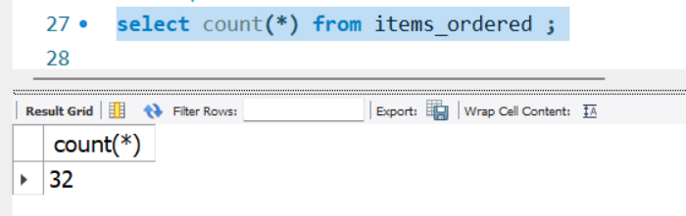
(Aggregate Functions)
What are the total number of rows in the items_ordered table?
Prasun Karar

Slide 9
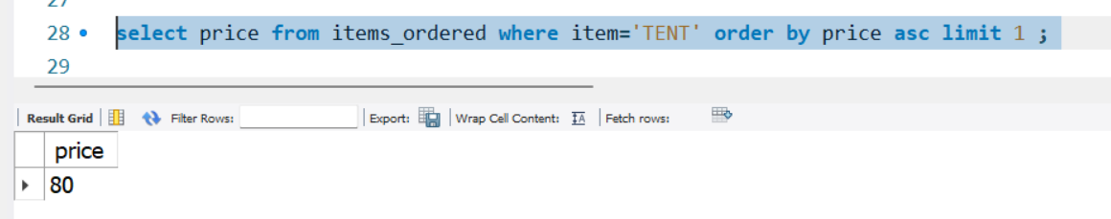
(Aggregate Functions)
For all of the tents that were ordered in the items_ordered table, what is the price of the lowest
tent?
Hint: Your query should return the price only.
Prasun Karar

Slide 10
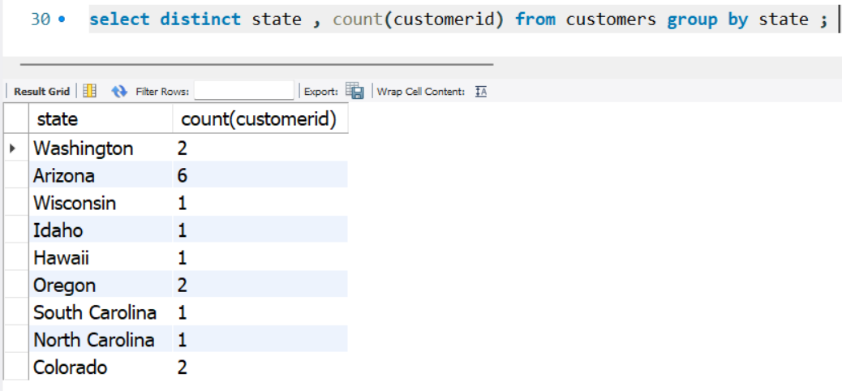
(Group By clause)
How many people are in each unique state in the customers table? Select the state and display
the number of people in each.
Hint: count is used to count rows in a column, sum works on
numeric data only.
Prasun Karar

Slide 11
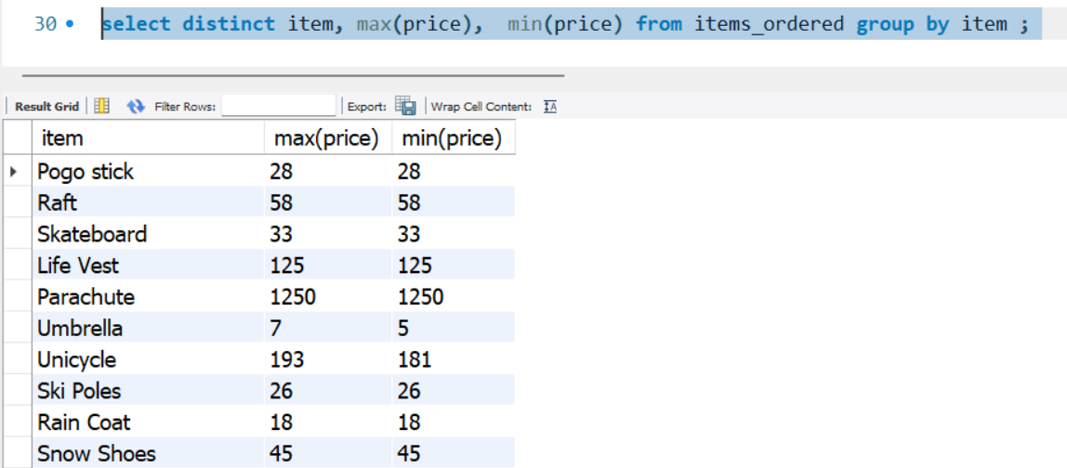
(Group By clause)
From the items_ordered table, select the item, maximum price, and minimum price for each
specific item in the table.
Hint: The items will need to be broken up into separate groups.
Prasun Karar

Slide 12
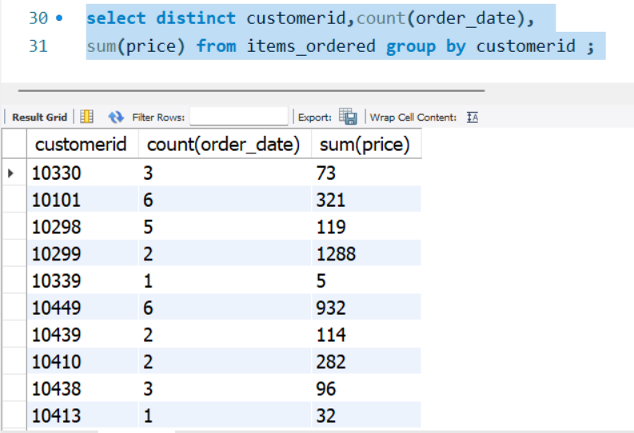
(Group By clause)
How many orders did each customer make? Use the items_ordered table. Select the
customerid, number of orders they made, and the sum of their orders. Click the Group By
answers link below if you have any problems.
Prasun Karar

Slide 13
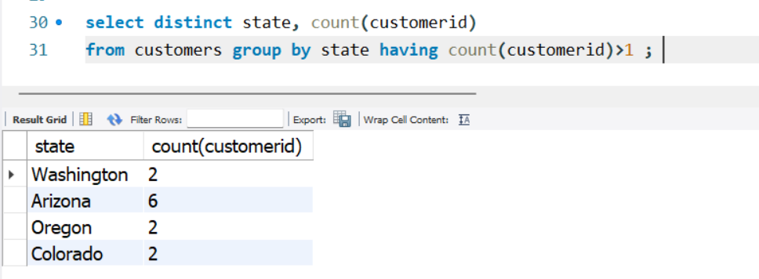
(HAVING clause)
How many people are in each unique state in the customers table that have more than one
person in the state? Select the state and display the number of how many people are in each if
it's greater than 1.
Prasun Karar

Slide 14
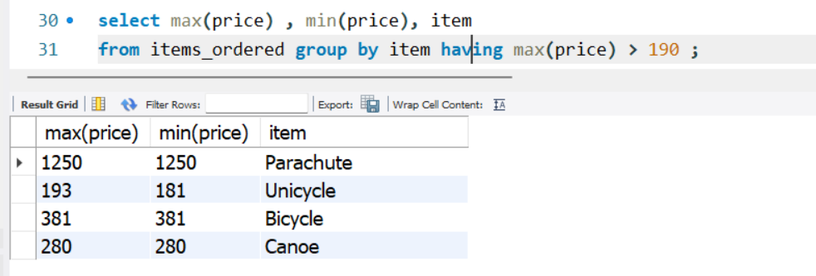
(HAVING clause)
From the items_ordered table, select the item, maximum price, and minimum price for each
specific item in the table. Only display the results if the maximum price for one of the items is
greater than 190.00.
Prasun Karar

Slide 15
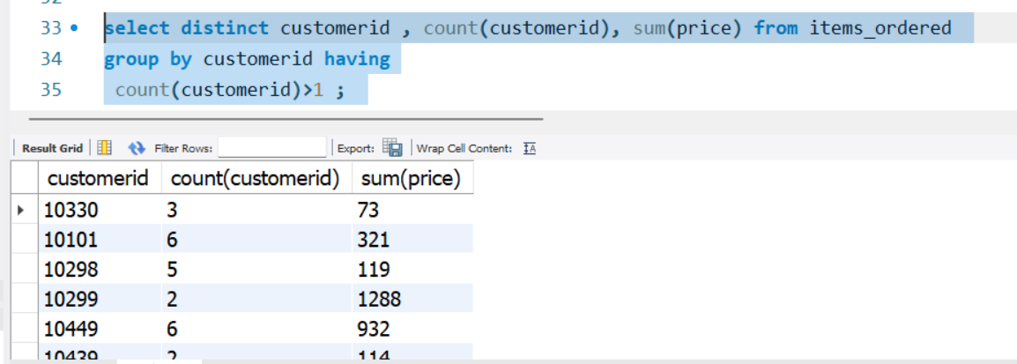
(HAVING clause)
How many orders did each customer make? Use the items_ordered table. Select the
customerid, number of orders they made, and the sum of their orders if they purchased more
than 1 item.
Prasun Karar

Slide 16
(ORDER BY clause)
Select the lastname, firstname, and city for all customers in the customers table. Display the
results in Ascending Order based on the lastname.
select lastname, firstname, city from customers order by lastname asc ;
Same thing as exercise #1, but display the results in Descending order.
select lastname, firstname, city from customers order by lastname DESC ;
Prasun Karar

Slide 17
(ORDER BY clause)
Select the item and price for all of the items in the items_ordered table that the price is greater
than 10.00. Display the results in Ascending order based on the price.
select item , price from items_ordered where price > 10 order by price asc ;
Prasun Karar

Slide 18
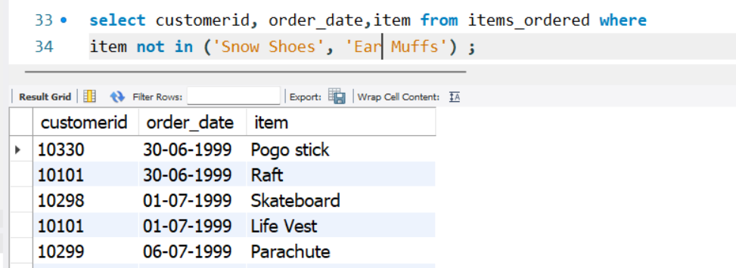
(Combining Conditions & Boolean Operators)
Select the customerid, order_date, and item from the items_ordered table for all items unless
they are 'Snow Shoes' or if they are 'Ear Muffs'. Display the rows as long as they are not either of
these two items.
Prasun Karar

Slide 19
(Combining Conditions & Boolean Operators)
Select the item and price of all items that start with the letters 'S', 'P', or 'F'.
-- Item name first letter starts with S | P | F
SELECT item, price
FROM your_table_name
WHERE REGEXP_LIKE(item, '^(S|P|F)’);
--OR
SELECT item, priceFROM items_orderedWHERE UPPER(SUBSTRING(item, 1, 1)) IN ('S', 'P', 'F');
-- Item name first letter doesn’t start with S | P | F
SELECT item, price
FROM your_table_name
WHERE NOT REGEXP_LIKE(item, '^(S|P|F)');
Prasun Karar

Slide 20
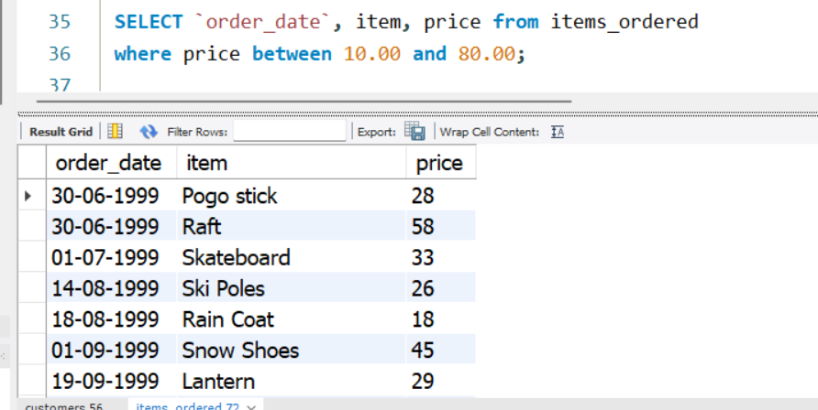
(IN & Between)
Select the date, item, and price from the items_ordered table for all of the rows that have a
price value ranging from 10.00 to 80.00.
NOTE→ ‘IN’ operator used for exact match whereas ‘BETWEEN’ operator used for range
Prasun Karar

Slide 21
(IN & Between)
Select the firstname, city, and state from the customers table for all of the rows where the state
value is either: Arizona, Washington, Oklahoma, Colorado, or Hawaii.
SELECT firstname, city, state from customers where state='Arizona' OR state='Washington'OR state='Oklahoma'OR state='Colorado'OR state='Hawaii’;
-- OR
SELECT firstname, city, state from customers where state in ('Arizona' , 'Washington','Oklahoma' ,'Colorado’) ;
--OR
SELECT firstname, city, state from customers where REGEXP_LIKE(state, '(Arizona|Washington|Oklahoma)');
Prasun Karar

Slide 22
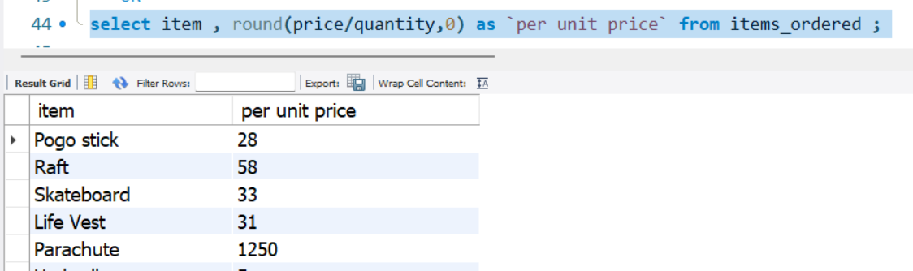
(Mathematical Functions)
Select the item and per unit price for each item in the items_ordered table.
Hint: Divide the price by the quantity.
Prasun Karar

Slide 23
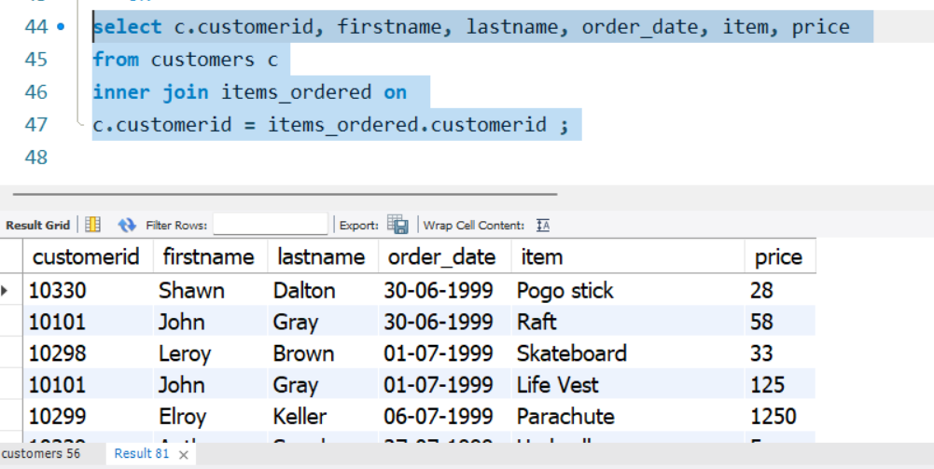
Exercises 9 (Table Joins)
Write a query using a join to determine which items were ordered by each of the customers in
the customers table. Select the customerid, firstname, lastname, order_date, item, and price for
everything each customer purchased in the items_ordered table.
Prasun Karar

Slide 24
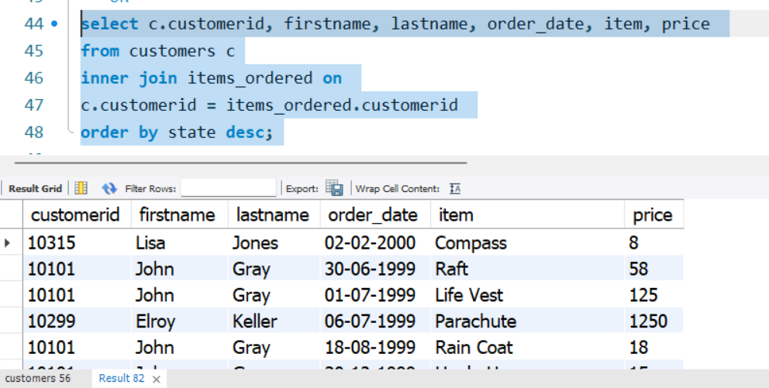
Exercises 9 (Table Joins)
Repeat exercise #1, however display the results sorted by state in descending order.
Prasun Karar

